Slide 1
„Café-au-lait”- Spots
Dr. György Fekete
II. Department of Pediatrics
Semmelweis University, Budapest

Slide 2
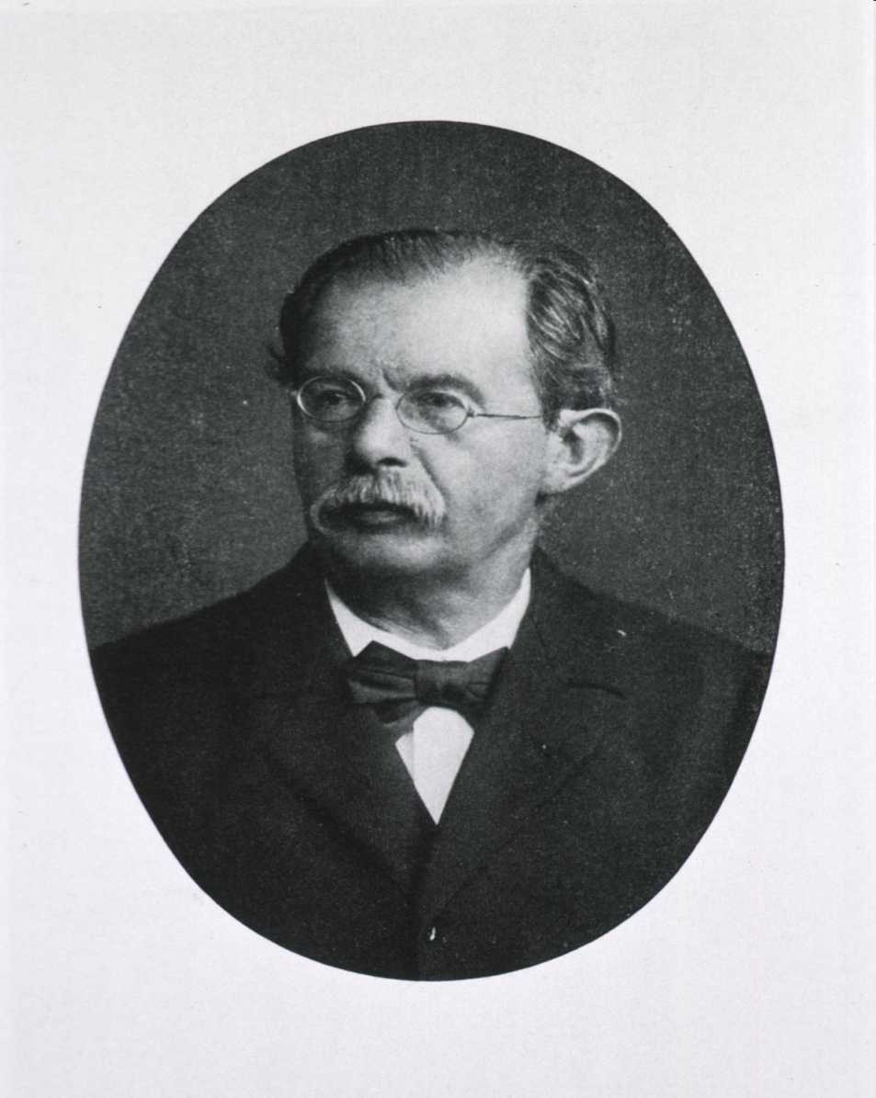
Friedrich Daniel von Recklinghausen (1833 – 1910)
German pathologist
Gütersloh - Würzburg - Strassburg

Slide 3
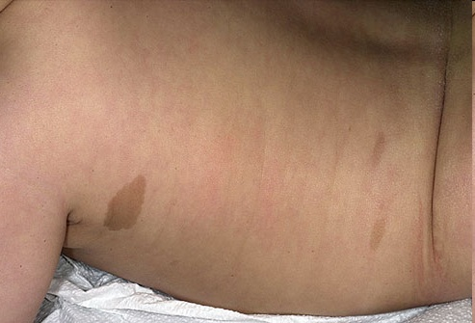
Neurofibromatosis type 1 (NF1)
Prevalence: 1/ 2500 – 1/3000
Diagnostic criteria: 2 or more of the following points are present
6 or more café- au -lait spots, diameter > 5 mm. (prepuberty), and > 15 mm. (postpuberty)

Slide 4
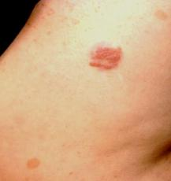
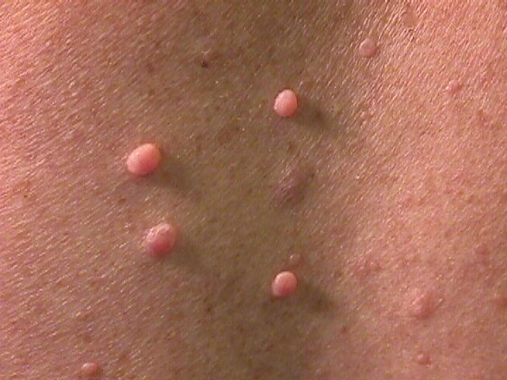
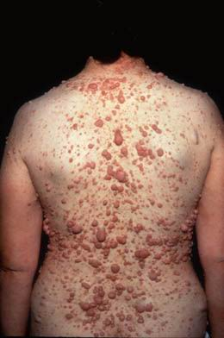
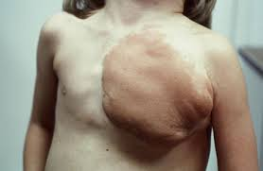
2 or more neurofibromas (fibromatous tumors of the skin), or at least one plexiform neurofibroma

Slide 5
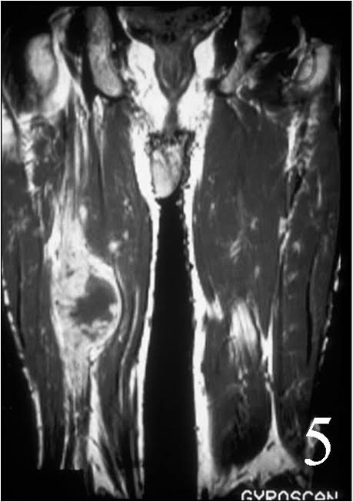
Plexiform neurofibromas
potential for transformation into malignant peripheral nerve sheath tumors
(malignant schwannomas)

Slide 6
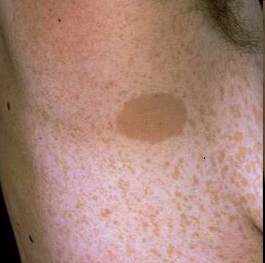
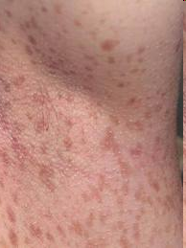
Axillary and/ or inguinal freckling

Slide 7
Optic pathway glioma, spinal neurofibromas
2 or more melanocytic iris hamartomas (Lisch nodules )

Slide 8
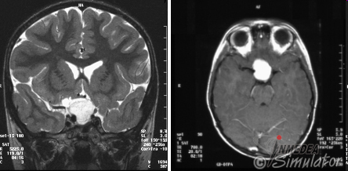
Optic glioma precocious puberty , visual loss

Slide 9
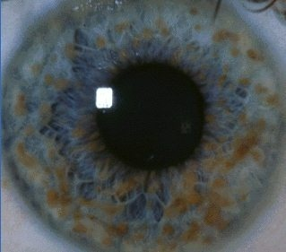
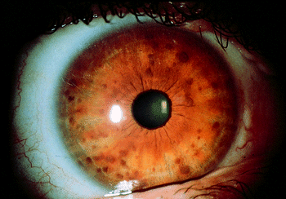
Lisch nodules

Slide 10
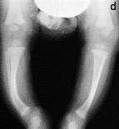
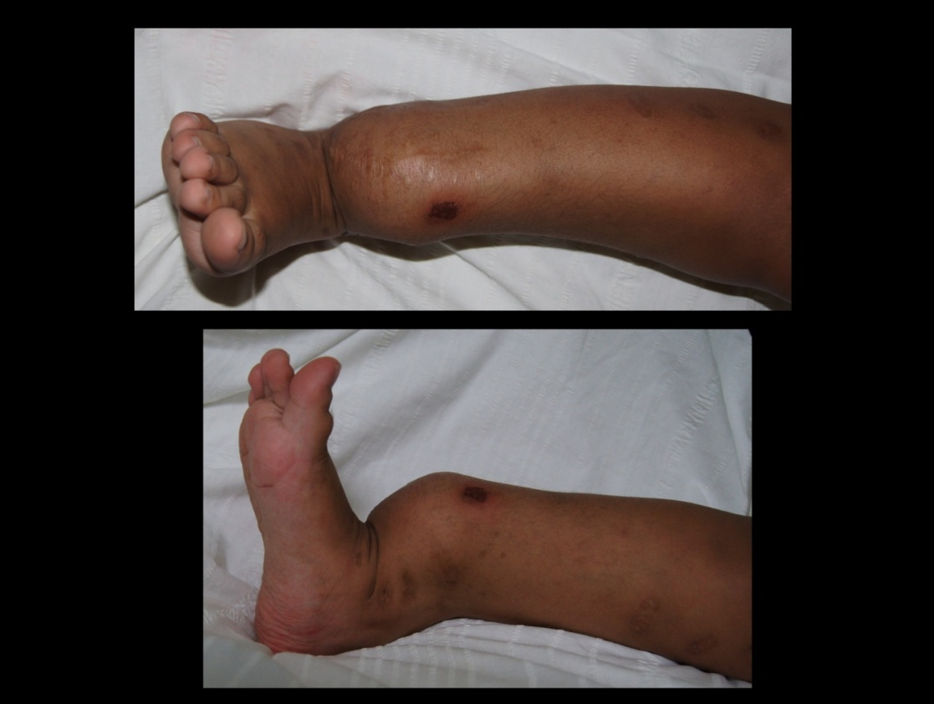
Specific bone lesions
Dysplasia of long bones ,
pseudoarthrosis of tibia, thinning of long bone cortex

Slide 11
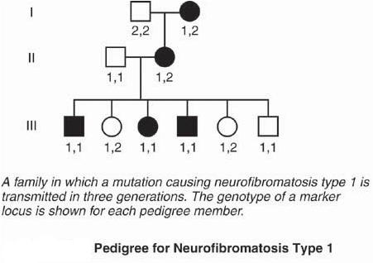
First –degree family relative has a proven diagnosis of neurofibromatosis
National Institutes of Health Consensus Conference 1987

Slide 12
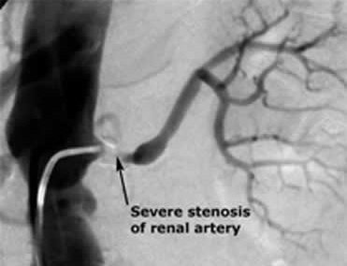
Vascular manifestations
Renal artery stenosis
Hypertension

Slide 13
NF1- symptoms of 59 male and 43 female pediatric patients
Males % Females%
Café-au-lait
sp. 100 100
Neurofibroma 54,2 34,9
Plexiform
neurofibroma 33,9 27,9
Freckling 59,3 65,1
Optic glioma 30,5 25,6
Iris nodules 39,0 32,6
Orthop. spine sympt. 61,0 32,6
Other bone lesions 28,8 7,0
Krumbholz A. et al. Monatsch Kinderheilk 2008, 156:893- 898.

Slide 14
Some infants and children present only with „café –au – lait” spots
without any other neurofibromatosis symptom and sign (innocent spots): regular pediatric observation is needed
macrocephaly (occipitofrontal circumference: >97. percentile)
short stature (< 3. percentile), early dentition (< 5 mo.) : suspected NF1 new mutation
complications: learning disabilities, mental retardation, tumors (CNS, neurofibrosarcoma)

Slide 15
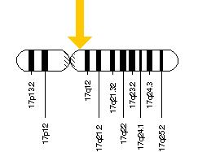
NF1-gene , chromosome 17 (17q11.2)
Genetic code of neurofibromin synthesis. Regulation of signal –transduction -protein RAS
GTPase activation
61 exons
NF1 gene mutations occur also in juvenile myelomonocytic leukemia, Watson syndrome, and breast cancer
50% of cases are due to de novo mutations
Sporadic occurrence is associated
with advanced paternal age

Slide 16
NF1 in one family
P.K., ♀, birth date: 15. 08. 2001
P.M., ♂, birth date: 10. 02.1998
many „café – au – lait” spots
the mother died at the age of 34 yrs.
Dg.: Neurofibromatosis type I., optic glioma,
maternal grandmother and a sister had the same disease
11 and 6 yrs. old brother and sister are healthy

Slide 17
P.K., ♀
2003: AML (acute myelocytic leukemia)
2004: Stem cell transplantation , full remission

Slide 19
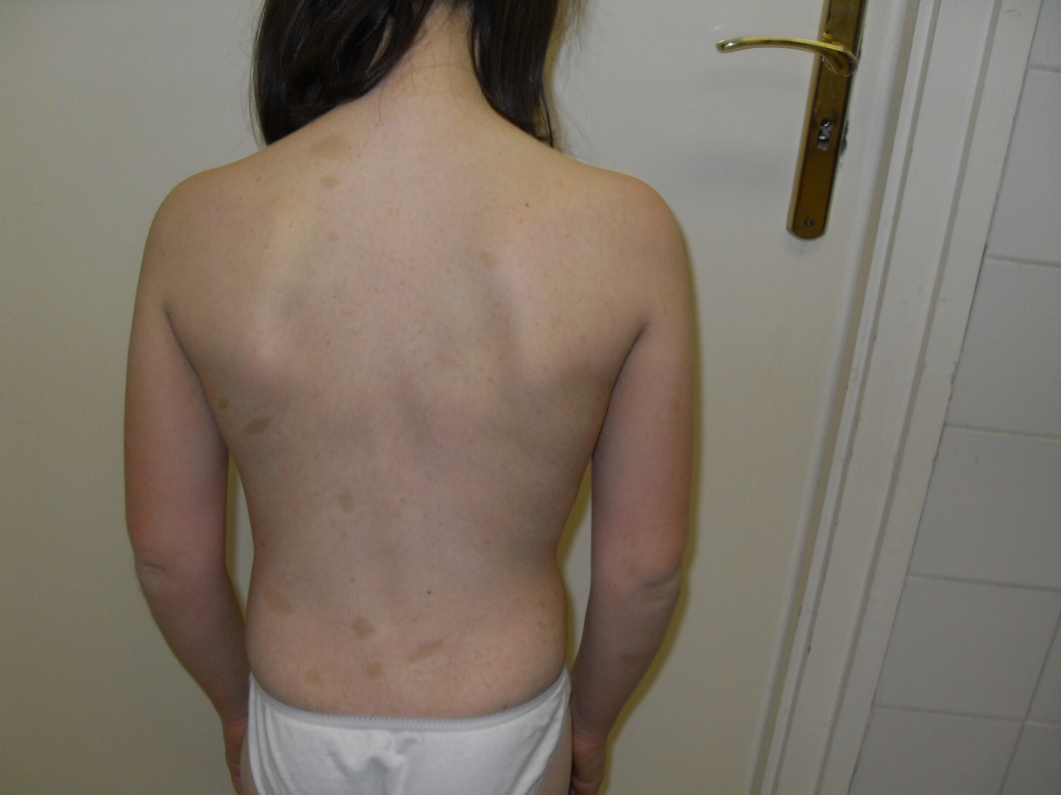

Slide 20
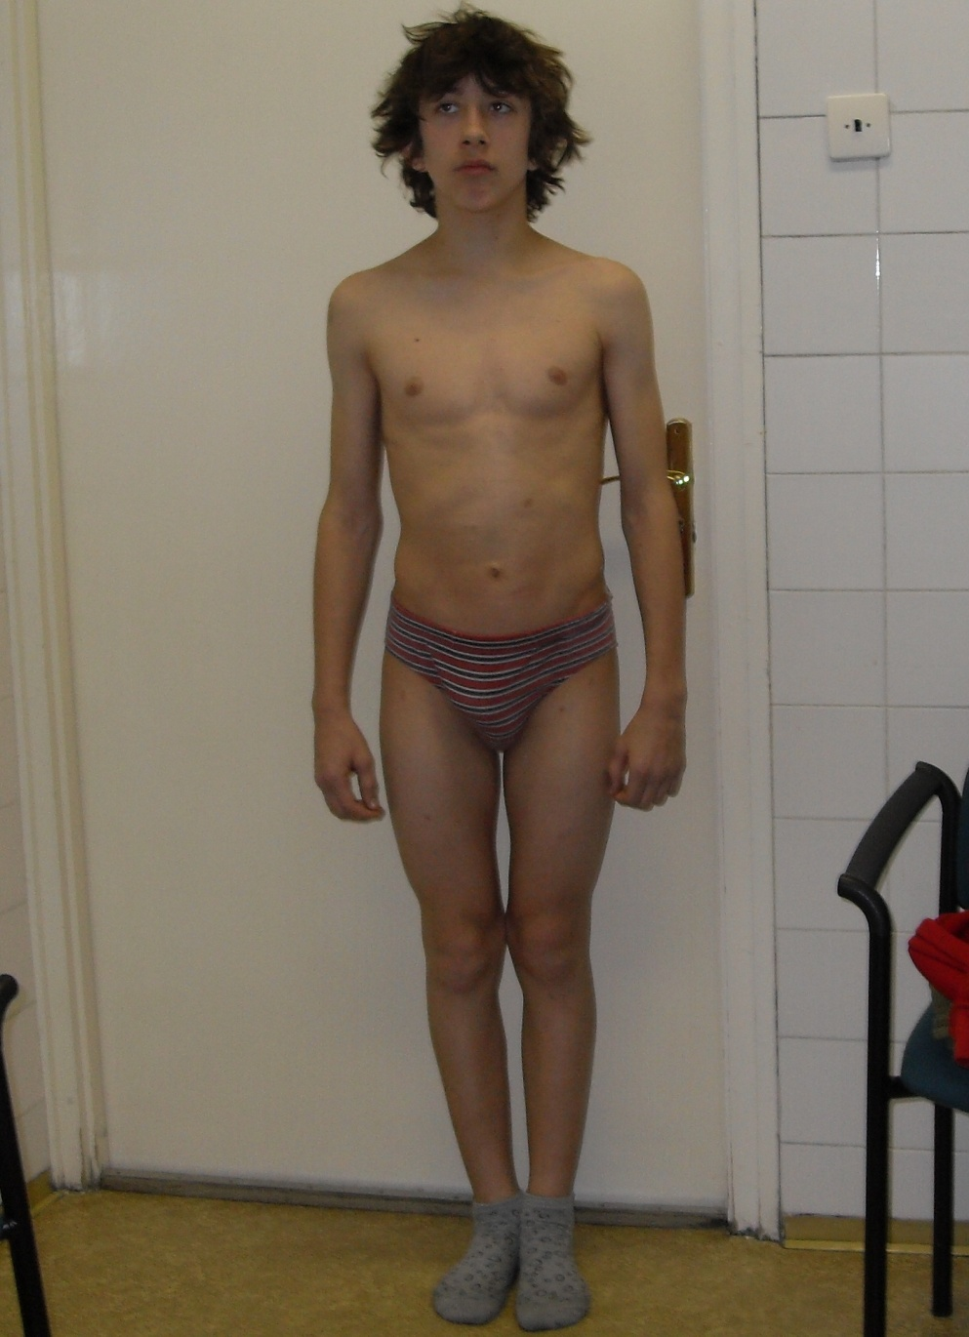
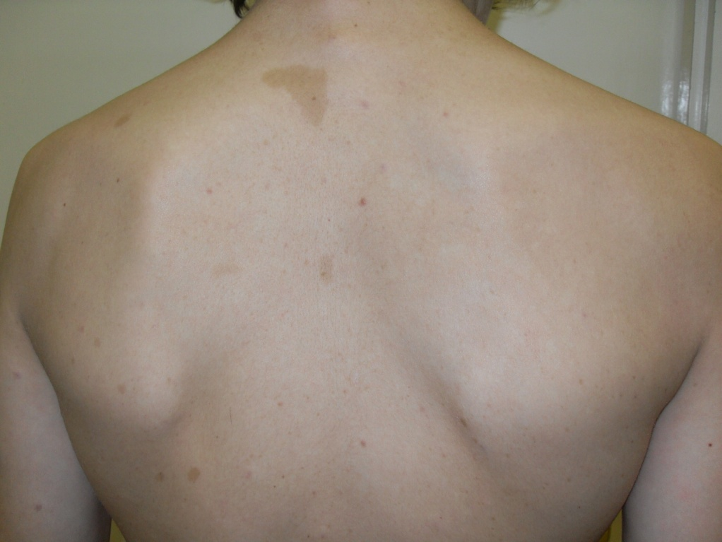

Slide 21
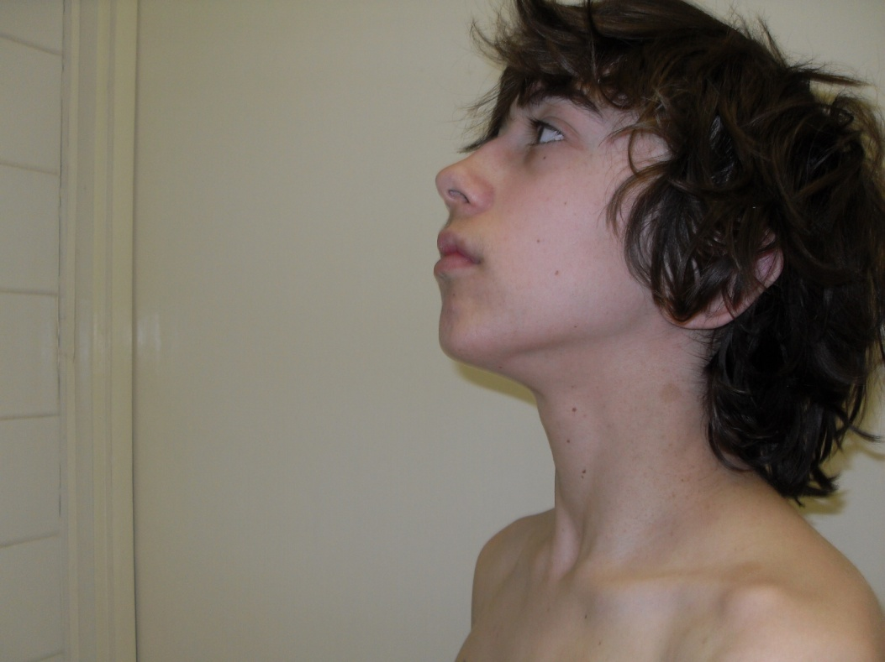
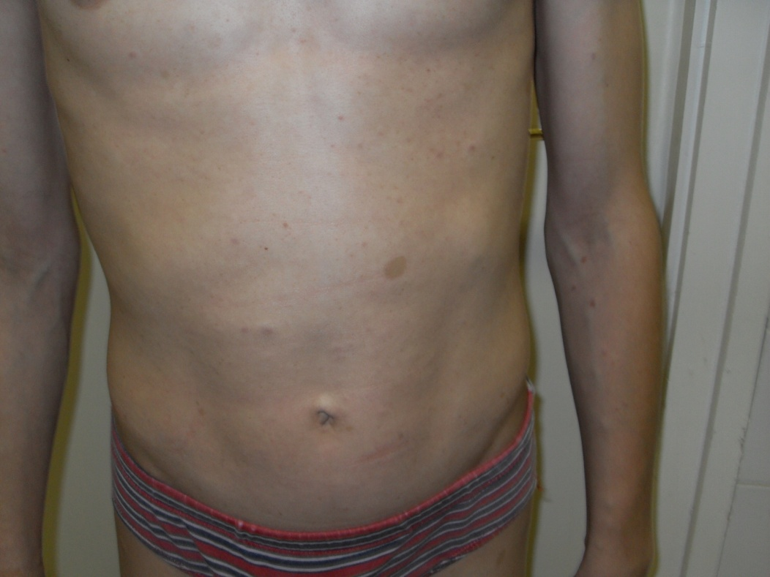

Slide 22
Differential diagnosis
Healthy children: 19 / 1000 newborn babies (Michalk D, Schönau E,1999)
Ovarial cysts
Juvenile xanthogranuloma

Slide 23
Legius syndrome
SPRED1 mutations (15q13.2)
NO Lisch nodules, neurofibromas, optic gliomas, bone lesions
Subcutaneous lipomas in adults
7 coding exons

Slide 24
McCune – Albright syndrome
precocious puberty
„café –au – lait” spots
fibrotic bone dysplasia
Overfunction of endocrine organs
GNAS1 – gene mutations

Slide 25
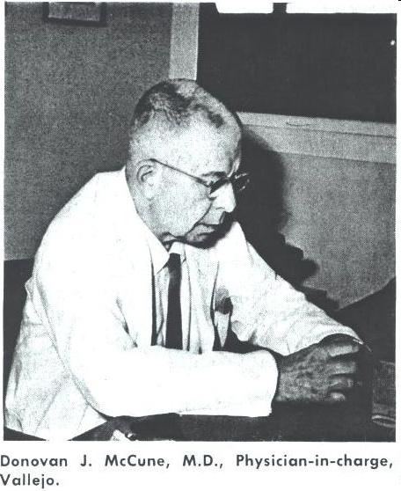
Donovan James McCune (1902-1976) pediatrician, USA

Slide 26
Fuller Albright (1900 – 1969), internist, endocrinologist, USA

Slide 27
McCune – Albright - Syndrom P olyostotic fibrous dysplasia
AD, GNAS1 – gene, 20q13.32,
”gain-on function” mutations
Guanine nucleotide – binding protein, alpha – stimulating activity polypeptide 1
„loss of function” mutations: Pseudohypoparathyreoidism Ia, Ib, Ic
Pseudopseudohypoparathyreoidism
Progressive bone heteroplasia

Slide 28
Pseudohypoparathyreoidismus type Ia
AD
Short stature, obesity
Round face
Mental retardation
Cataract, nystagmus
Delayed tooth eruption
Basal ganglion calcification
Brachydactyly
Short metacarpals and metatarsals (especially 4th and 5th)
Hypocalcemia, hyperphosphatemia
Hypogonadism
Hypothyroidism

Slide 29
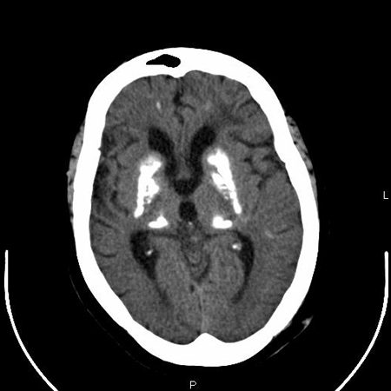
nature.com
bestpractice.bmj.com

Slide 30
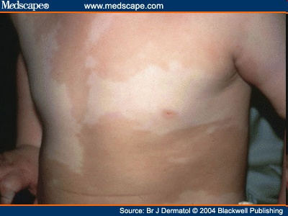
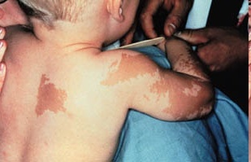
McCune – Albright syndrome
history.nih.gov

Slide 31
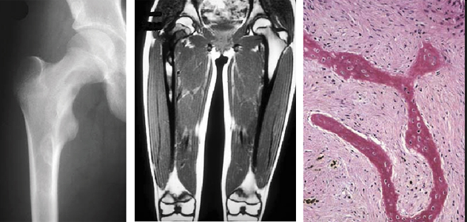
medscape.org

